Slide 1
RL algorithms analysis

Slide 2
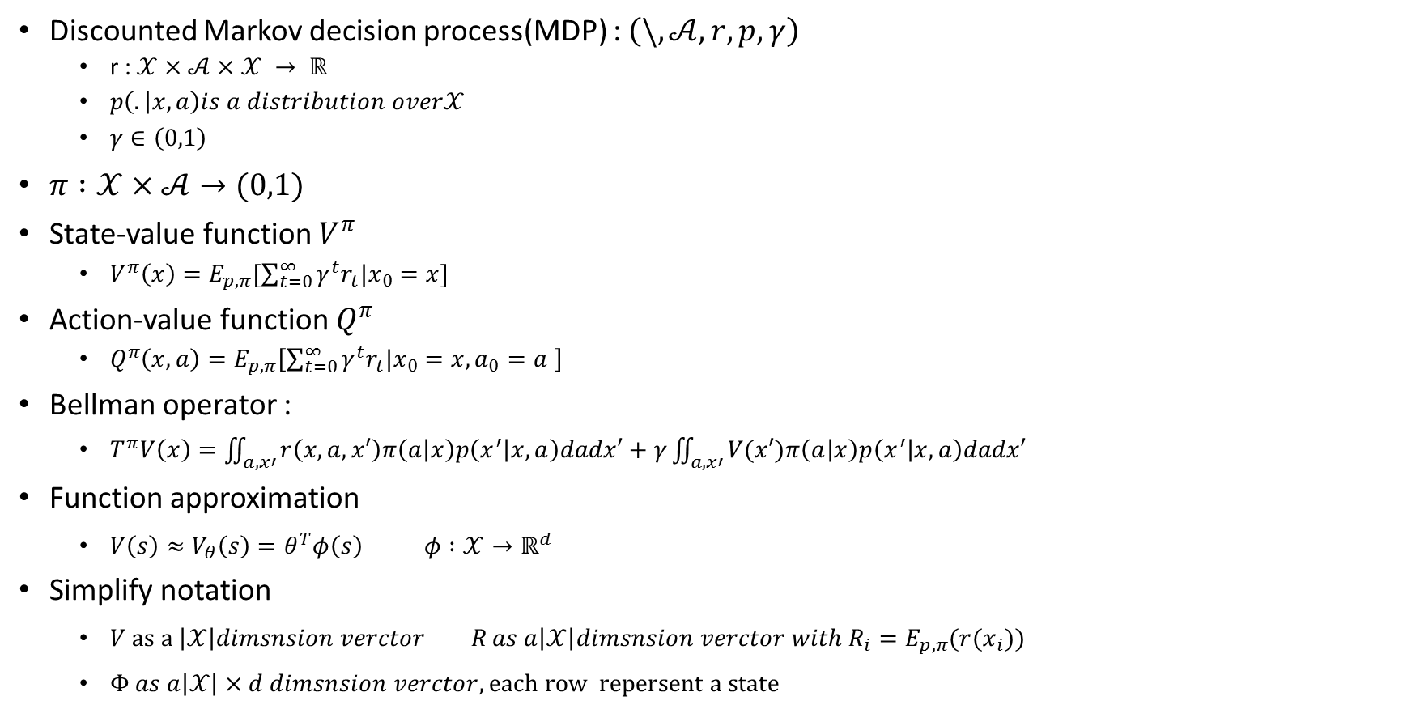
Discounted Markov decision process(MDP) : $\left(\backslash ,𝒜,r,p,γ\right)$
r : $𝒳×𝒜×𝒳 → ℝ$
$p\left(. | x,a\right)is a distribution over𝒳$
$γ∈\left(0,1\right)$
$π :𝒳×𝒜→(0,1)$
State-value function $V^{π}$
$V^{π}\left(x\right)=E_{p,π}[\sum_{t=0}^{∞}{γ^{t}r_{t}|x_{0}=x}]$
Action-value function $Q^{π}$
$Q^{π}\left(x,a\right)=E_{p,π}\left[\sum_{t=0}^{∞}{γ^{t}r_{t}|x_{0}=x,a_{0}=a }\right]$
Bellman operator :
$T^{π}V\left(x\right)=\iint_{a,x′}{r\left(x,a,x′\right)π\left(a | x\right)p\left(x^{′} | x,a\right)dadx′}+γ\iint_{a,x′}{V(x′)π\left(a | x\right)p\left(x^{′} | x,a\right)dadx′}$
Function approximation
$V\left(s\right)≈V_{θ}\left(s\right)=θ^{T}φ\left(s\right) φ :𝒳→ℝ^{d}$
Simplify notation
$V as a \left|𝒳\right|dimsnsion verctor R as a\left|𝒳\right|dimsnsion verctor with R_{i}=E_{p,π}(r(x_{i}))$
$Φ as a\left|𝒳\right|×d dimsnsion verctor, each row repersent a state$

Slide 3

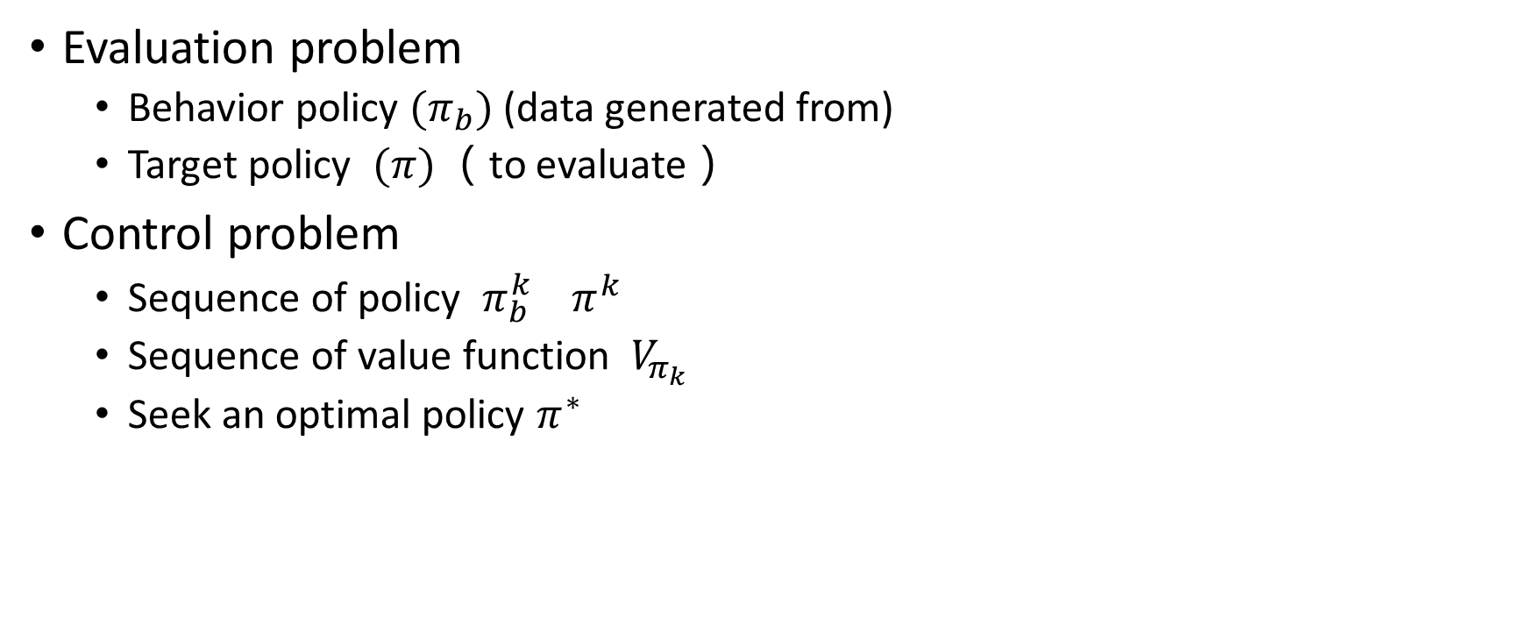
Evaluation problem
Behavior policy $(π_{b})$ (data generated from)
Target policy $(π)$ （to evaluate）
Control problem
Sequence of policy $π_{b}^{k} π^{k}$
Sequence of value function $V_{π_{k}}$
Seek an optimal policy $π^{∗}$
On policy : $π_{b}=π$
Off policy : $π_{b}≠π$

Slide 4
Evaluation problem
Algorithms for evaluation :
Objection function + optimization techniques

Slide 5

Objective function
$δ=r_{t}+{\left(γϕ_{t+1 }−ϕ_{t}\right)}^{T}θ$
$ϕ_{t}=ϕ(s_{t})$ $D=diag[d^{π}\left(s_{1}\right),…]$
$MSE\left(θ\right)={\left\|V_{θ}−V^{π}\right\|}_{D}^{2}=\sum_{i=1}^{m}{d^{π}\left(s_{i}\right){\left[V_{θ}\left(s_{i}\right)−V^{π}\left(s_{i}\right)\right]}^{2}=E_{d}\left[{\left[V_{θ}\left(s\right)−V^{π}\left(s\right)\right]}^{2} | s_{i}=s_{i}\right]}$
Monte-Carlo
$MSBE\left(θ\right)={\left\|V_{θ}−{TV}_{θ}\right\|}_{D}^{2}=E_{d}\left[E_{p,π}{\left[δ | s_{t}\right]}^{2}\right]=E_{d}\left[{\left({\left(E_{p,π}\left[γφ_{t+1} | s_{t}\right]−φ_{t}\right)}^{T}θ+E_{p,π}\left[r_{t} | s_{t}\right]\right)}^{2}\right]$
Double sampling
$MSTDE\left(θ\right)=E_{d}\left[E_{p,π}\left[δ^{2} | s_{t}\right]\right]=E_{d,p,π}\left[δ^{2}\right]$
Residual td learning
$MSPBE\left(θ\right)={\left\|V_{θ}−{ΠTV}_{θ}\right\|}_{D}^{2}={\left\|V_{θ}−{TV}_{θ}\right\|}_{DΦ{\left(Φ^{T}DΦ\right)}^{−1}Φ^{T}D}^{2}=E_{d,π,p}{\left[φ_{t}δ_{t}\right]}^{T}E_{d}\left[φ_{t}φ_{t}^{T}\right]E_{d,π,p}\left[φ_{t}δ_{t}\right]={\left\|Φ^{T}D(V_{θ}−{TV}_{θ})\right\|}_{{\left(Φ^{T}DΦ\right)}^{−1}}^{2}$
LSTD, GTD2, TDC
$NEU\left(θ\right)={\left\|{Φ^{T}D(V}_{θ}−{TV}_{θ})\right\|}_{2}^{2}=E_{d,p,π}{\left[δφ\right]}^{T}E_{d,p,π}\left[δφ\right]$
GTD
OPE-FPE
$$θ={argmin}_{θ^{′}}OPE\left(θ^{′},w\right)={argmin}_{θ^{′}}\left\|V_{θ^{′}}−{TV}_{w}\right\|$$
$$w=argmin_{w^{′}}FPE\left(θ,w′\right)={argmin}_{w′}\left\|V_{θ}−{TV}_{w′}\right\|$$
TD learning

Slide 6
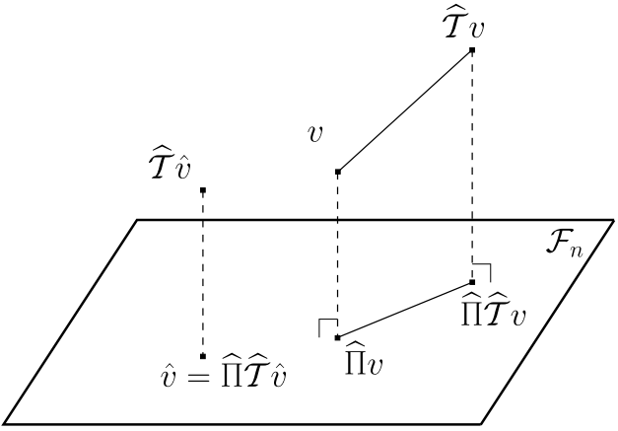
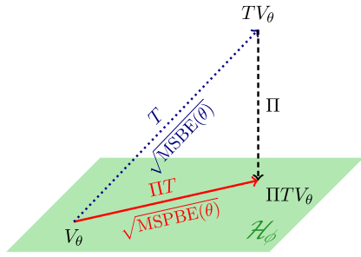
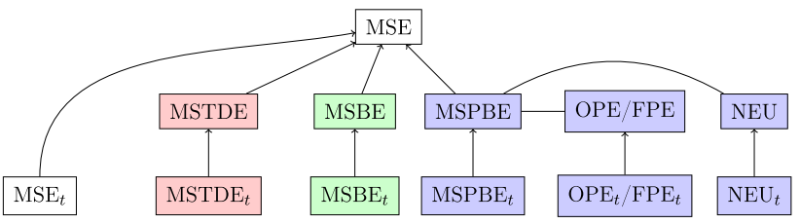
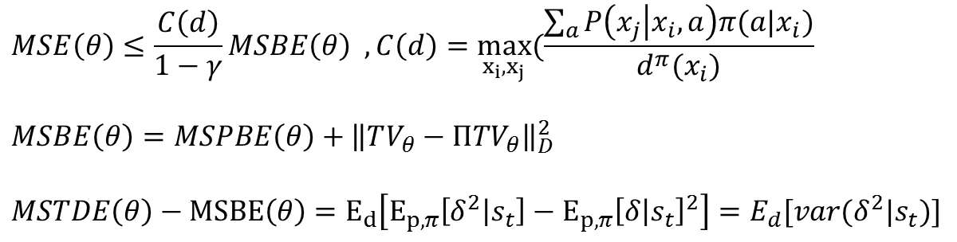
Objective function
$$MSE\left(θ\right)≤\frac{C\left(d\right)}{1−γ}MSBE\left(θ\right) ,C\left(d\right)=\max_{x_{i},x_{j}}(\frac{\sum_{a}{P\left(x_{j} | x_{i},a\right)π(a|x_{i})}}{d^{π}(x_{i})}$$
$$MSBE\left(θ\right)=MSPBE\left(θ\right)+{\left\|TV_{θ}−ΠTV_{θ}\right\|}_{D}^{2}$$
$MSTDE\left(θ\right)−MSBE\left(θ\right)=E_{d}\left[E_{p,π}\left[δ^{2} | s_{t}\right]−E_{p,π}{\left[δ | s_{t}\right]}^{2}\right]=E_{d}[var(δ^{2}|s_{t})]$

Slide 7
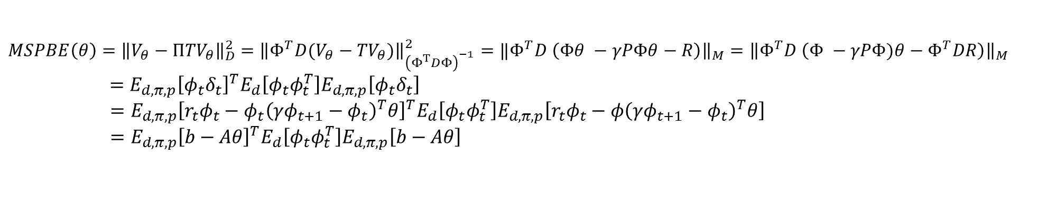
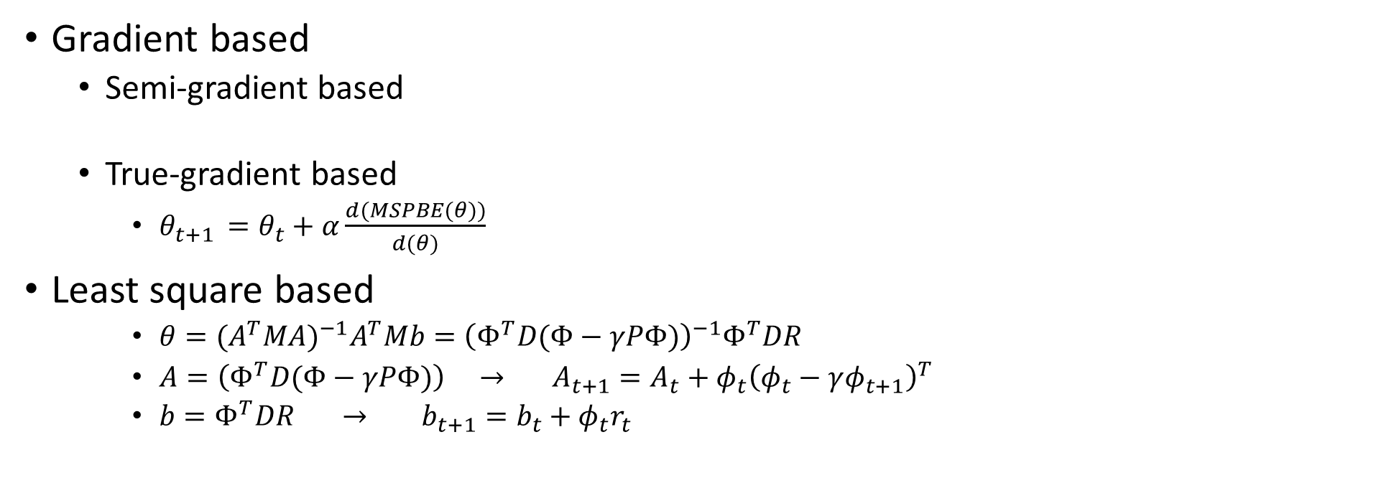
optimization techniques
$MSPBE\left(θ\right)={\left\|V_{θ}−{ΠTV}_{θ}\right\|}_{D}^{2}$ $={\left\|Φ^{T}D(V_{θ}−{TV}_{θ})\right\|}_{{\left(Φ^{T}DΦ\right)}^{−1}}^{2}=‖Φ^{T}D \left(Φθ −γPΦθ−R\right){\left.​\right\|}_{M}={\left\|Φ^{T}D \left(Φ −γPΦ)θ−Φ^{T}DR\right)\right\|}_{M}$
$$=E_{d,π,p}{\left[φ_{t}δ_{t}\right]}^{T}E_{d}\left[φ_{t}φ_{t}^{T}\right]E_{d,π,p}\left[φ_{t}δ_{t}\right]$$
$=E_{d,π,p}{\left[r_{t}φ_{t}−{φ_{t}\left(γφ_{t+1}−φ_{t}\right)}^{T}θ\right]}^{T}E_{d}\left[φ_{t}φ_{t}^{T}\right]E_{d,π,p}\left[r_{t}φ_{t}−{φ\left(γφ_{t+1}−φ_{t}\right)}^{T}θ\right]$
$=E_{d,π,p}{\left[b−Aθ\right]}^{T}E_{d}\left[φ_{t}φ_{t}^{T}\right]E_{d,π,p}\left[b−Aθ\right]$
Gradient based
Semi-gradient based
True-gradient based
$θ_{t+1 }=θ_{t}+α\frac{d(MSPBE(θ))}{d(θ)}$
Least square based
$θ=({A^{T}MA)}^{−1}A^{T}Mb={\left(Φ^{T}D(Φ−γPΦ)\right)}^{−1}Φ^{T}DR$
$A=\left(Φ^{T}D(Φ−γPΦ)\right) → A_{t+1}=A_{t}+φ_{t}{\left(φ_{t}−γφ_{t+1}\right)}^{T}$
$b=Φ^{T}DR → b_{t+1}=b_{t}+φ_{t}r_{t}$

Slide 8

Off policy
On policy : $π_{b}=π$
Off policy : $π_{b}≠π$
Importance sampling
Weighted importance sampling

Slide 9

Off-policy TD learning
$θ_{t+1 }=θ_{t}+α_{t}ρ_{t}δ_{t}{φ(s}_{t})$
$ρ_{t}=\frac{π_{G\left(a_{t} | s_{t}\right)}}{π_{B\left(a_{t} | s_{t}\right)}}$

Slide 10

Off-policy LSTD
$θ=({A^{T}MA)}^{−1}A^{T}Mb={\left(Φ^{T}D(Φ−γPΦ)\right)}^{−1}Φ^{T}DR$
$A=\left(Φ^{T}D(Φ−γPΦ)\right) → A_{t+1}=A_{t}+φ_{t}{\left(φ_{t}−γφ_{t+1}\right)}^{T}$
$b=Φ^{T}DR → b_{t+1}=b_{t}+φ_{t}r_{t}$

Slide 11
eligibility traces

Slide 12
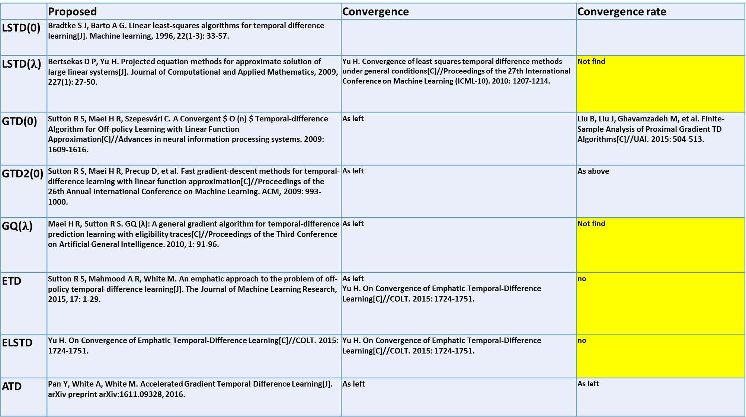
 | Proposed | Convergence | Convergence rate
LSTD(0) | Bradtke S J, Barto A G. Linear least-squares algorithms for temporal difference learning[J]. Machine learning, 1996, 22(1-3): 33-57.
LSTD($λ$) | Bertsekas D P, Yu H. Projected equation methods for approximate solution of large linear systems[J]. Journal of Computational and Applied Mathematics, 2009, 227(1): 27-50. | Yu H. Convergence of least squares temporal difference methods under general conditions[C]//Proceedings of the 27th International Conference on Machine Learning (ICML-10). 2010: 1207-1214. | Not find
GTD(0) | Sutton R S, Maei H R, Szepesvári C. A Convergent $ O (n) $ Temporal-difference Algorithm for Off-policy Learning with Linear Function Approximation[C]//Advances in neural information processing systems. 2009: 1609-1616. | As left | Liu B, Liu J, Ghavamzadeh M, et al. Finite-Sample Analysis of Proximal Gradient TD Algorithms[C]//UAI. 2015: 504-513.
GTD2(0) | Sutton R S, Maei H R, Precup D, et al. Fast gradient-descent methods for temporal-difference learning with linear function approximation[C]//Proceedings of the 26th Annual International Conference on Machine Learning. ACM, 2009: 993-1000. | As left | As above
GQ($λ$) | Maei H R, Sutton R S. GQ (λ): A general gradient algorithm for temporal-difference prediction learning with eligibility traces[C]//Proceedings of the Third Conference on Artificial General Intelligence. 2010, 1: 91-96. | As left | Not find
ETD | Sutton R S, Mahmood A R, White M. An emphatic approach to the problem of off-policy temporal-difference learning[J]. The Journal of Machine Learning Research, 2015, 17: 1-29. | As left Yu H. On Convergence of Emphatic Temporal-Difference Learning[C]//COLT. 2015: 1724-1751. | no
ELSTD | Yu H. On Convergence of Emphatic Temporal-Difference Learning[C]//COLT. 2015: 1724-1751. | Yu H. On Convergence of Emphatic Temporal-Difference Learning[C]//COLT. 2015: 1724-1751. | no
ATD | Pan Y, White A, White M. Accelerated Gradient Temporal Difference Learning[J]. arXiv preprint arXiv:1611.09328, 2016. | As left | As left

Slide 13
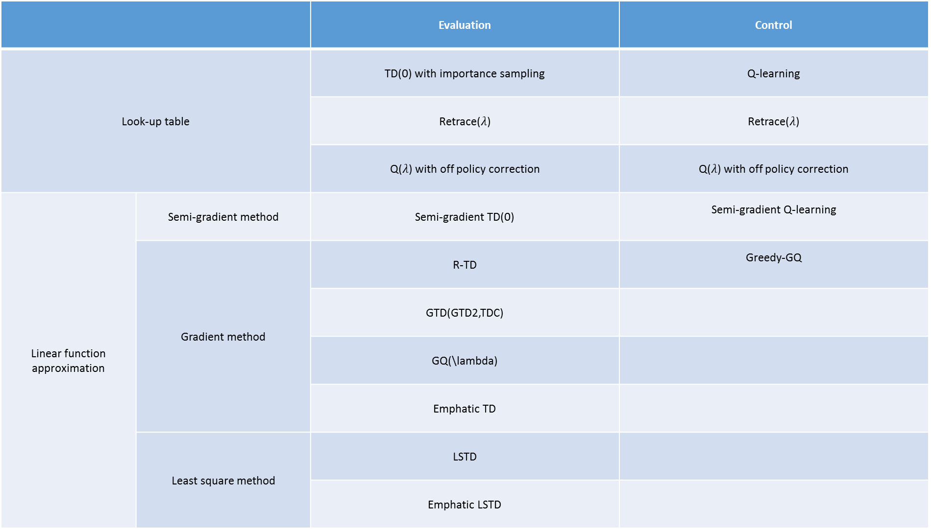
 |  | Evaluation | Control
Look-up table |  | TD(0) with importance sampling | Q-learning
 |  | Retrace($λ$) | Retrace($λ$)
 |  | Q($λ$) with off policy correction | Q($λ$) with off policy correction
Linear function approximation | Semi-gradient method | Semi-gradient TD(0) | Semi-gradient Q-learning
 | Gradient method | R-TD | Greedy-GQ
 |  | GTD(GTD2,TDC)
 |  | GQ(\lambda)
 |  | Emphatic TD
 | Least square method | LSTD
 |  | Emphatic LSTD

Slide 14
[1] H. Yu JANEYHZYU, “On Convergence of Emphatic Temporal-Difference Learning *,” 2015.
[1] R. S. Sutton, A. R. Mahmood, and M. White, “An Emphatic Approach to the Problem of Off-policy Temporal-Difference Learning,” J. Mach. Learn. Res., vol. 17, pp. 1–29, 2016.
[1] A. Hallak, A. Tamar, R. Munos, and S. Mannor, “Generalized Emphatic Temporal Difference Learning: Bias-Variance Analysis,” in Proceedings of the 30th Conference on Artificial Intelligence (AAAI 2016), 2016, no. Yu, pp. 1–17.
[1] A. Harutyunyan, M. G. Bellemare, T. Stepleton, and R. Munos, “Q(??) with off-policy corrections,” Lect. Notes Comput. Sci. (including Subser. Lect. Notes Artif. Intell. Lect. Notes Bioinformatics), vol. 9925 LNAI, pp. 305–320, 2016.
[1] R. Munos, T. Stepleton, A. Harutyunyan, and M. Bellemare, “Safe and Efficient Off-Policy Reinforcement Learning,” Nips, pp. 1046–1054, 2016.
[1] B. Liu, J. Liu, M. Ghavamzadeh, S. Mahadevan, and M. Petrik, “Finite-Sample Analysis of Proximal Gradient TD Algorithms,” Uai, 2015.
[1] I. Osband and B. Van Roy, “On Lower Bounds for Regret in Reinforcement Learning,” pp. 1–10, 2016.
[1] M. Tagorti and B. Scherrer, “On the Rate of Convergence and Error Bounds for LSTD (λ).,” ICML, 2015.
[1] A. R. Mahmood, H. van Hasselt, and R. S. Sutton, “Weighted importance sampling for off-policy learning with linear function approximation,” Proc. Adv. Neural Inf. Process. Syst., pp. 1–12, 2014.

Slide 15
On the rate of convergence and error bounds for LSTD($λ$)

Slide 16

On converge of emphatic temporal difference learning

Slide 17
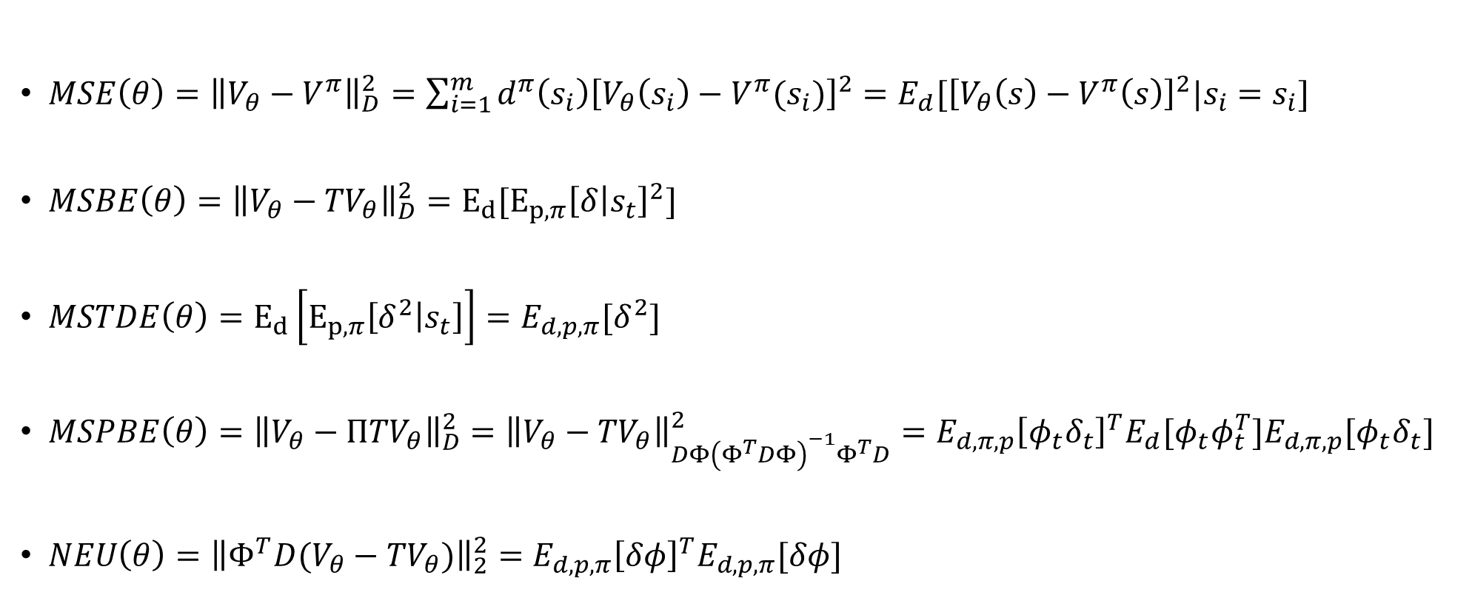
$MSE\left(θ\right)={\left\|V_{θ}−V^{π}\right\|}_{D}^{2}=\sum_{i=1}^{m}{d^{π}\left(s_{i}\right){\left[V_{θ}\left(s_{i}\right)−V^{π}(s_{i})\right]}^{2}=E_{d}[{\left[V_{θ}\left(s\right)−V^{π}\left(s\right)\right]}^{2}|s_{i}=s_{i}]}$
$MSBE\left(θ\right)={\left\|V_{θ}−{TV}_{θ}\right\|}_{D}^{2}=E_{d}[E_{p,π}{\left[δ | s_{t}\right]}^{2}]$
$MSTDE\left(θ\right)=E_{d}\left[E_{p,π}\left[δ^{2} | s_{t}\right]\right]=E_{d,p,π}[δ^{2}]$
$MSPBE\left(θ\right)={\left\|V_{θ}−{ΠTV}_{θ}\right\|}_{D}^{2}={\left\|V_{θ}−{TV}_{θ}\right\|}_{DΦ{\left(Φ^{T}DΦ\right)}^{−1}Φ^{T}D}^{2}=E_{d,π,p}{\left[φ_{t}δ_{t}\right]}^{T}E_{d}[φ_{t}φ_{t}^{T}]E_{d,π,p}[φ_{t}δ_{t}]$
$NEU\left(θ\right)={\left\|{Φ^{T}D(V}_{θ}−{TV}_{θ})\right\|}_{2}^{2}=E_{d,p,π}{\left[δφ\right]}^{T}E_{d,p,π}[δφ]$
Notes:
$$={\left[V_{θ}−V^{π}\right]}^{T}D\left[V_{θ}−V^{π}\right]$$

Slide 18
Evaluation problem
Look up table setting

Slide 19
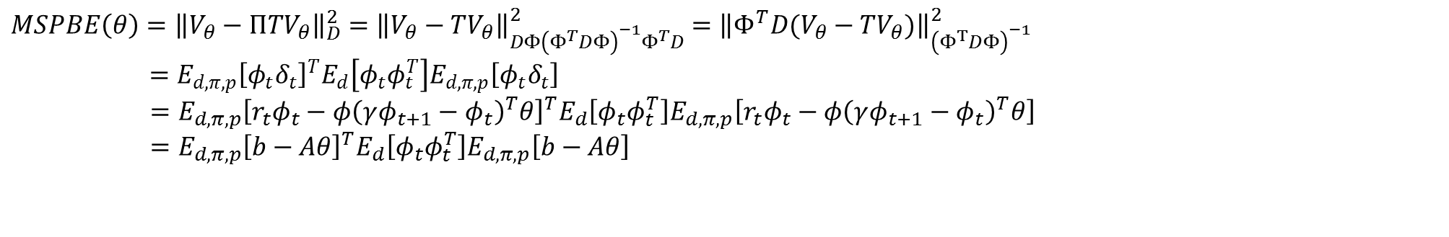
$MSPBE\left(θ\right)={\left\|V_{θ}−{ΠTV}_{θ}\right\|}_{D}^{2}={\left\|V_{θ}−{TV}_{θ}\right\|}_{DΦ{\left(Φ^{T}DΦ\right)}^{−1}Φ^{T}D}^{2}$ $={\left\|Φ^{T}D(V_{θ}−{TV}_{θ})\right\|}_{{\left(Φ^{T}DΦ\right)}^{−1}}^{2}$
$$=E_{d,π,p}{\left[φ_{t}δ_{t}\right]}^{T}E_{d}\left[φ_{t}φ_{t}^{T}\right]E_{d,π,p}\left[φ_{t}δ_{t}\right]$$
$=E_{d,π,p}{\left[r_{t}φ_{t}−{φ\left(γφ_{t+1}−φ_{t}\right)}^{T}θ\right]}^{T}E_{d}\left[φ_{t}φ_{t}^{T}\right]E_{d,π,p}\left[r_{t}φ_{t}−{φ\left(γφ_{t+1}−φ_{t}\right)}^{T}θ\right]$
$=E_{d,π,p}{\left[b−Aθ\right]}^{T}E_{d}\left[φ_{t}φ_{t}^{T}\right]E_{d,π,p}\left[b−Aθ\right]$

